Slide 1
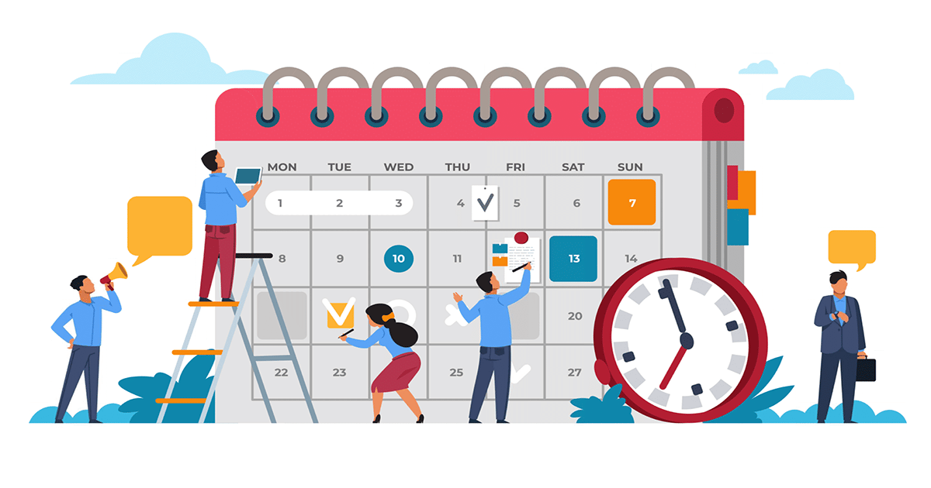


Slide 2
CONTENTS
  Foundations of planning
  Strategic planning
  Operational planning/ action plan

Slide 3

5.1 FOUNDATIONS OF PLANNING
Learning outcomes:
Define key concepts and explain the purposes of planning.
Classify the types of goals organizations might have and the plans they use.
Explain management by objectives (MBO)

Slide 4

What is planning?
Management function that involves:
Defining the organization’s goals
Establishing strategies for achieving those goals
Developing plans to integrate and coordinate work activities.
4

Slide 5
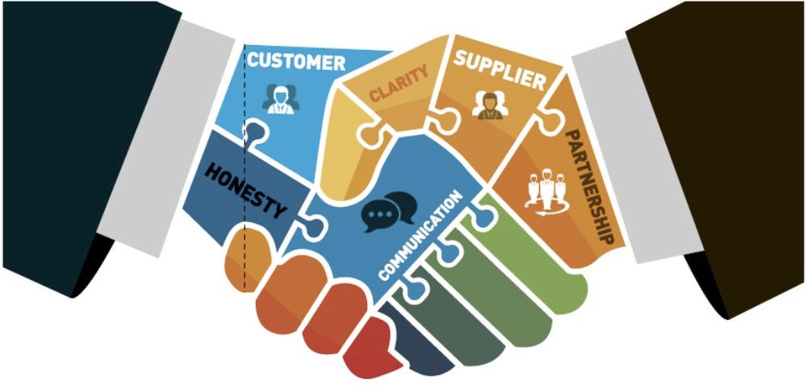

Goal
Goal is desired outcome or target. Goals can be classified:
  By content: Financial goals vs. Strategic goals
  By target audience: Stated goals vs. real goals
5

Slide 6
Goal
Example of organizational goals?
…..
…..
…..
6

Slide 7

Goal vs. Purpose
7

Slide 8
SIM’S MISSION
Khoa QLCN tạo ra giá trị về tri thức cho cộng đồng/xã hội thông qua sự kết hợp các hoạt động Sáng tạo tri thức (Nghiên cứu khoa học), Chuyển giao tri thức (Đào tạo) và Sử dụng tri thức (Tư vấn & Ứng dụng) trong lĩnh vực quản lý

Slide 9
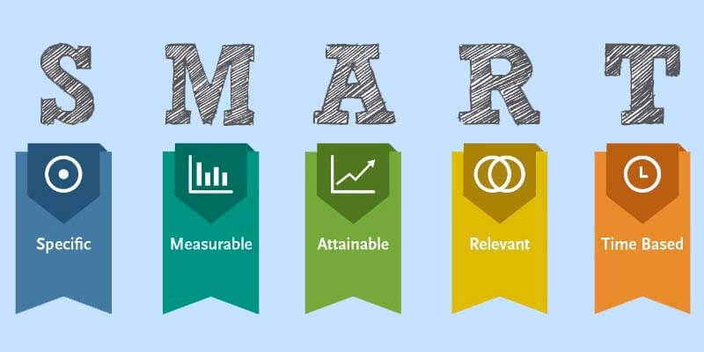
SMART Goals
What are the advantages of SMART goals?

Slide 10
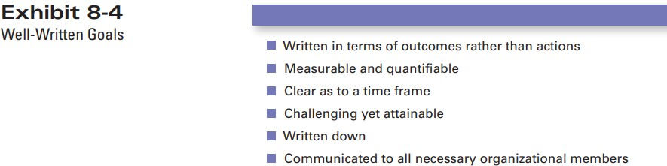
Well-Written goals

Slide 11
Strategy
Strategy is a unified, comprehensive, and integrated plan elating the strategic advantages of the firm to the challenges of the environment. It is designed to ensure that the basic objectives of the enterprise are achieved (Glueck, 1980)
Strategy are the plan for how the organization will do whatever it’s in business to do, how it will compete successfully, and how it will attract and satisfy its customers in order to achieve its goals (Robbin and Coulter, 2017)

Slide 12









Strategy
GOAL
WHAT TO DO/ ACT
RESOURCE ALLOCATION

Slide 13
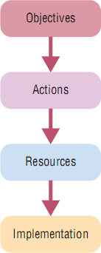
Plan
Plan is document outlining how goals are going to be met:
Four elements of a plan

Slide 14

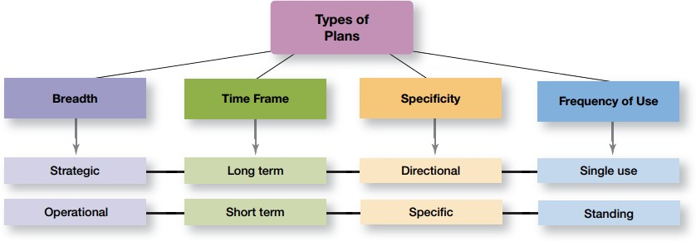
Plan

Slide 15





The roles of planning
MINIMIZES WASTE AND REDUNDANCY
REDUCES UNCERTAINTY
PROVIDES DIRECTION
SETS THE STANDARDS FOR CONTROLLING
15

Slide 16
Approaches to setting goals
Traditional goal-setting –top managers set goals that then flow down through the organization and become sub-goals for each organizational area.
Means-ends chain – an integrated network of goals in which the accomplishment of goals at one level serves as the means for achieving the goals, or ends, at the next level.

Slide 17
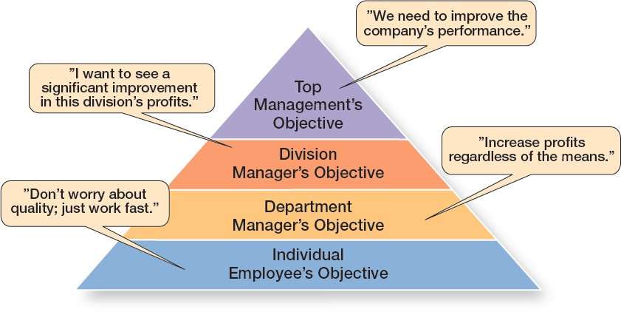
Approaches to setting goals
The Downside of Traditional Goal-Setting – Robbins and Counter (2017)

Slide 18
Approaches to setting goals
Management by objectives (MBO) – a process of setting mutually agreed upon goals and using those goals to evaluate employee performance.
Common elements of MBO:
  Goal specificity
  Participative decision making
  Set time period
  Performance feedback

Slide 19
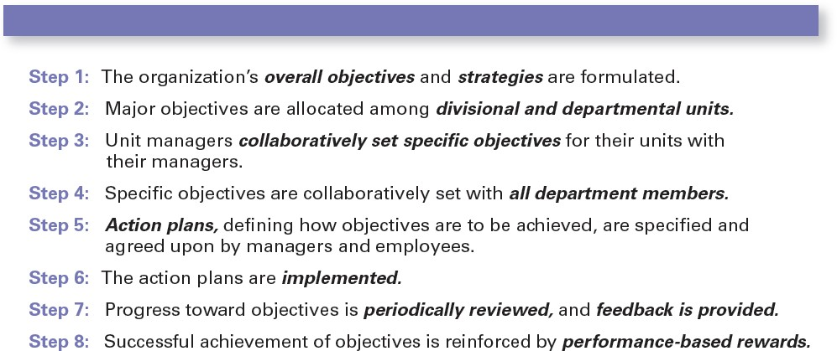
Approaches to setting goals
Steps in MBO

Slide 20
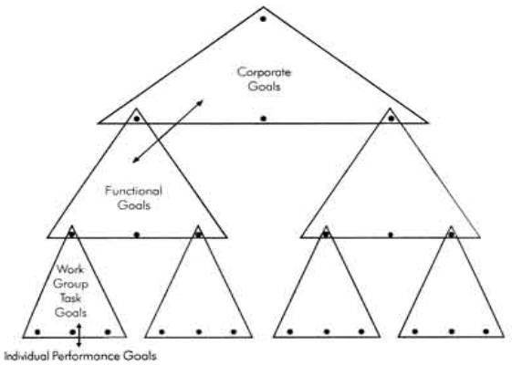
Approaches to setting goals
Management by objectives (MBO
Mutually agreed-upon goals

Slide 21

Approaches to setting goals
The advantages of MBO:
Identify key job tasks
Set specific and challenging
goals
Encourage active participation
Prioritize goals
Build in feedback
Link rewards to goal attainment

Slide 22
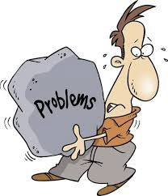
Approaches to setting goals
The problems with MBO
Efforts directed primarily toward output
Encourage individual rather than team efforts
Goals may discourage efforts for continuous improvement

Slide 23







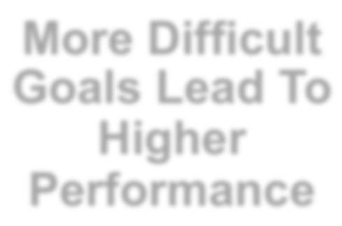






Approaches to setting goals
MBO work when:
Specific Goals Lead to Better Results
Support from Top Management Is Critical
More Difficult Goals Lead To Higher Performance
Active Participation
MBO WORK WHEN

Slide 24
5.2 STRATEGIC PLANNING
Learning outcomes:
Define strategic management and strategic planning
Explain what managers do during the six steps of the strategic management process and where is planning function among these six steps
Tell how to classify strategies

Slide 25
What is strategic management?
Strategic management is what managers do to develop the organization’s strategies. It’s an important task involving all the basic management functions—planning, organizing, leading, and controlling.

Slide 26
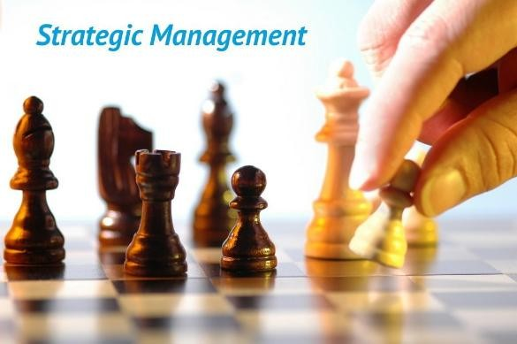
What is strategic management?
Q: Why strategic management is important?

Slide 27
“Without a strategy the organization is like a ship without a rudder”
Joel Ross and Michael Kami

Slide 28
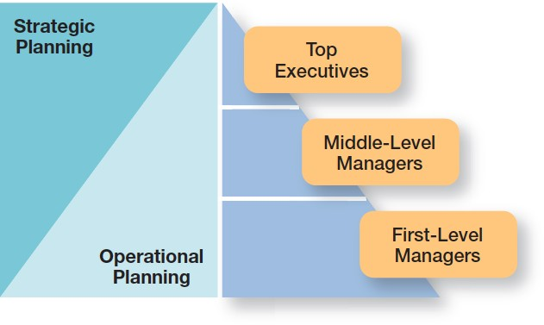
What is Strategic planning?

Slide 29

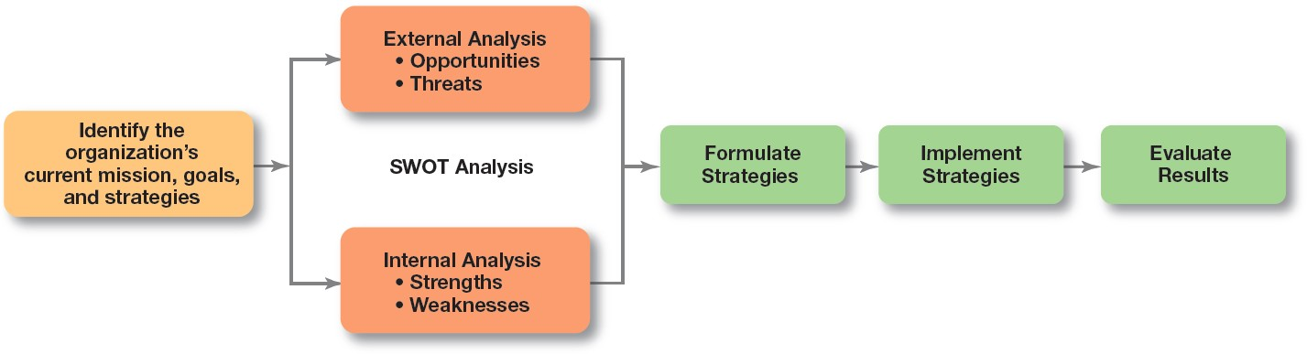
The strategic management process
STRATEGIC PLANNING

Slide 30


The 4 steps of strategic planning
STEP 1: Identifying the organization’s current mission, goals, and strategies:
Mission: a statement of the purpose of an organization.
Goals: the foundation for further planning.

Slide 31




The 4 steps of strategic planning STEP 2: Doing an External analysis
➔Pinpoint opportunities to exploit and threats to counteract or buffer against
Opportunities: positive trends in the external environment
Threats: negative trends in the external environment

Slide 32



The 4 steps of strategic planning STEP 3: Doing an Internal analysis
➔ identify organizational strengths to exploit and
weaknesses to correct
Strengths: any activities the organization does well or its unique resources
Weaknesses: activities the organization doesn’t do well or resources it needs but doesn’t possess

Slide 33
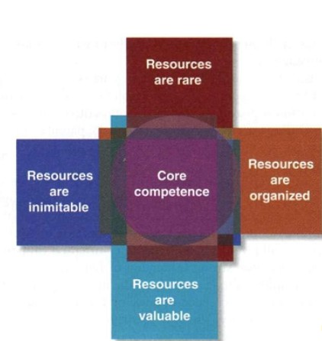
The 4 steps of strategic planning STEP 3: Doing an Internal analysis
Resources:
Capabilities:
Core competence
Competitive advantage

Slide 34
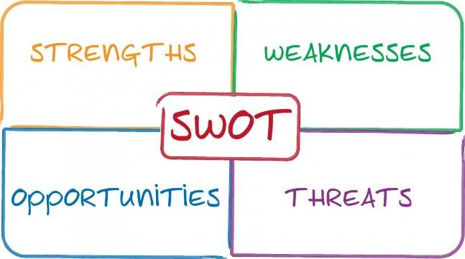
The 4 steps of strategic planning
SWOT ANALYSIS: The combined external and internal analyses

Slide 35

The 4 steps of strategic planning STEP 4: Formulating Strategies
Managers consider the realities of the external environment and their available resources and capabilities in order to design strategies that will help an organization achieve its goals

Slide 36
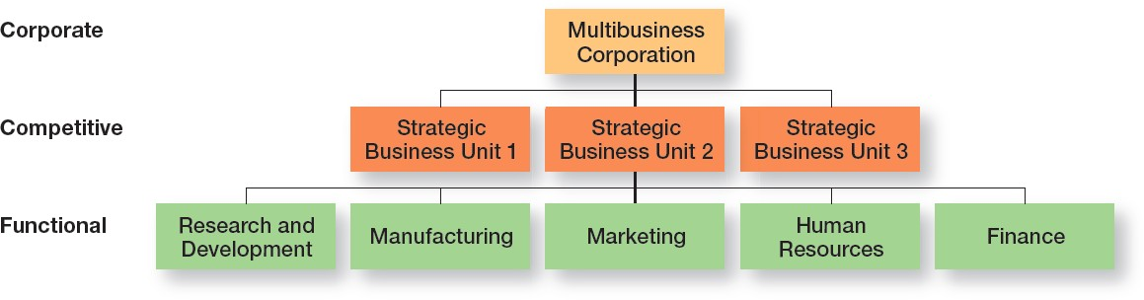
Three main types of strategies
Corporate strategies
Competitive strategies
Functional strategies

Slide 37
Corporate strategies
Corporate strategies - An organizational strategy the determine what businesses a company is in or wants to be in and what it wants to do with those businesses
Growth – expansion into new products and markets.
Stability – maintenance of the status quo
Renewal – examination of organizational
weaknesses that are leading to performance declines.
Combination – combine more than one strategy at the same time

Slide 38
Corporate strategies
Corporate strategies
Growth
Stability
Renewal
Concentration
Vertical Integration
Horizontal integration
Diversification

Slide 39
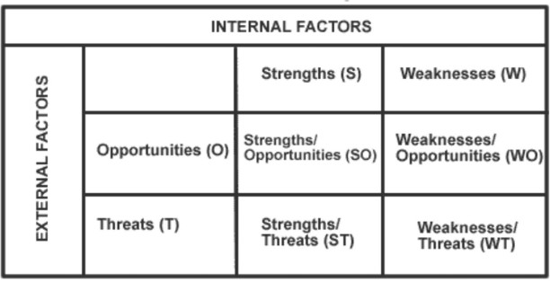
SWOT matrix

Slide 40
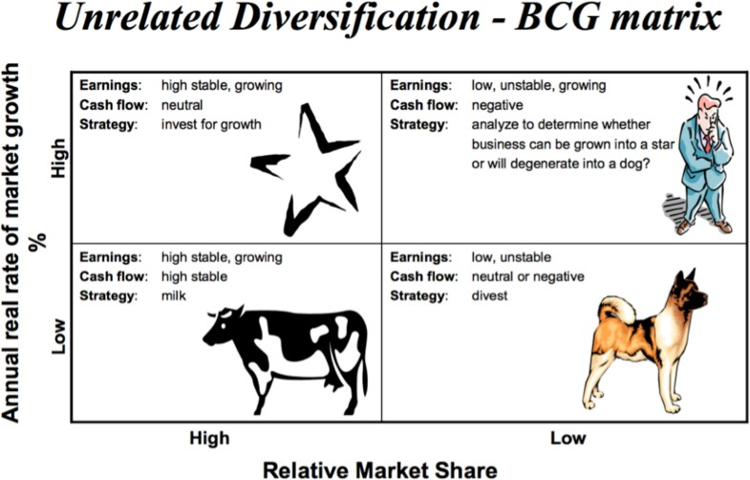
BCG matrix

Slide 41
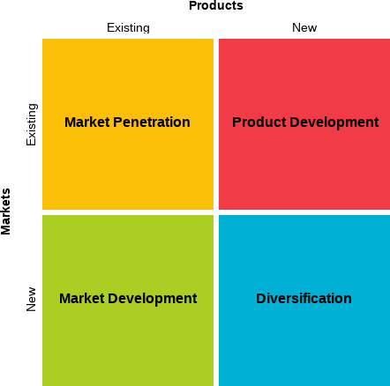
Ansoff matrix

Slide 42
Competitive strategies
Competitive strategy – an organizational strategy for how an organization will compete in its business(es).
Competitive advantage – what sets an organization apart; its distinctive edge.
  Quality as a Competitive Advantage
  Design Thinking as a Competitive Advantage
  Social media as competitive advantage
  Sustaining Competitive Advantage

Slide 43



Competitive strategies
Choosing a competitive strategy among:
Cost leadership strategy
Differentiation strategy
Focus strategy

Slide 44
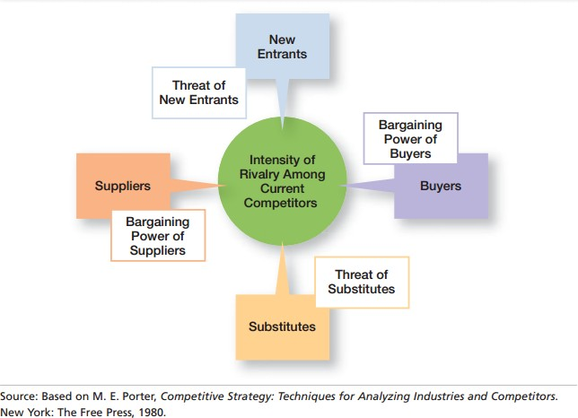
Five forces model

Slide 45
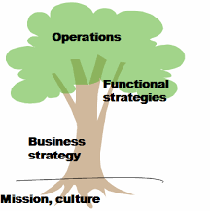
Functional strategies
The strategies used by an organization’s various functional departments to support the competitive strategy.

Slide 46
5.3 OPERATIONAL PLANNING
Learning outcomes:
Define operational planning
Explain the process of operational planning

Slide 47
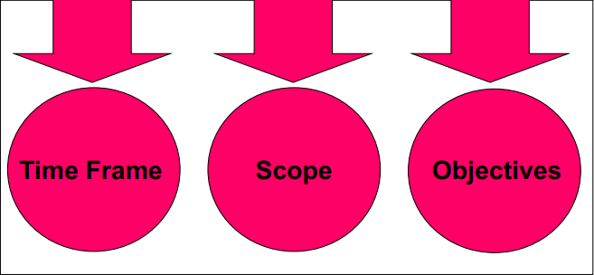
What is operational planning?
Planning for:
For a particular operational area
Short-term
How does strategic planning differ from operational planning?

Slide 48
The process of operational planning
Organization goals/ strategies
Operational planning
Single use
Repeated use
Program
Policies
Project
Rules
Budget
Procedures

Slide 49
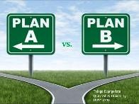




Planning in Dynamic environment
Stay alert to environmental changes
Plans are specific, but flexible
Continue formal planning in order to see any affect
Make the organizational hierarchy flatter

Slide 50

50

